Slide 1
In-Memory OLTP - باللغة العربية
Ayman El-Ghazali

Slide 2
Agenda
Architecture and Usage of In-Memory Optimized tables
Demo – In-Memory Optimized tables

Slide 3
In-memory Optimized tables Architecture
Data is stored physically as rows and not as pages
Data has full ACID Compliance but uses a Lock-Free architecture
Use of Optimistic concurrency controls for In-Memory tables eliminates the need for the lock manager, therefore no blocking is experienced
SQL Server uses snapshot-based isolation and conflict detection to guarantee consistency
Transaction Logging is used to establish durability by saving data to disk; option exists to create non-durable table or use delayed durability
Can be used in conjunction with natively compiled stored procedures which significantly increases performance
Can be used in conjunction with Table Partitioning for faster performance
Cold data is switched into a partitioned disk-based table based on a specific criteria; For example, when data is older than a week it goes to disk
Hot Data (In-Memory) → Staging Table (On Disk Partitioned) → Switch into Cold Data and create a view that does a UNION ALL between Hot and Cold Data

Slide 4
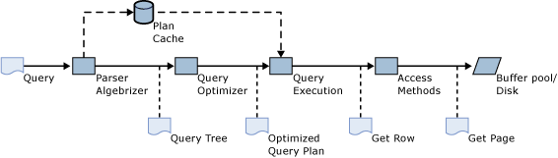
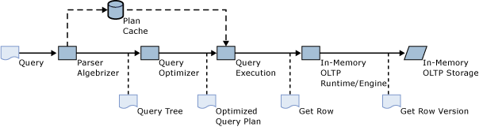
Query Processing for Disk-based Tables
Query Processing for In-Memory Optimized Tables
https://msdn.microsoft.com/en-us/library/dn205319.aspx

Slide 5
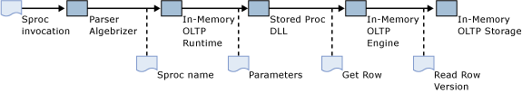
Query Processing for In-Memory Optimized Tables
Query Processing for Natively compiled stored procedure
https://msdn.microsoft.com/en-us/library/dn205319.aspx

Slide 6
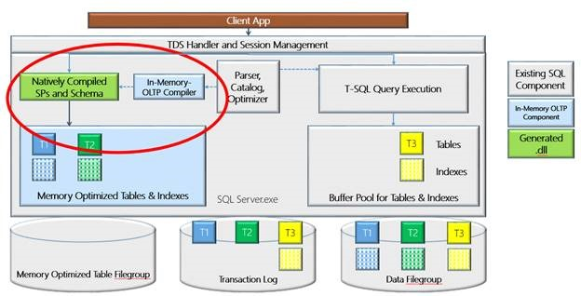
https://blogs.msdn.microsoft.com/saponsqlserver/2014/02/09/new-functionality-in-sql-server-2014-part4-in-memory-oltp/

Slide 7
In-memory Optimized tables Architecture
Indexes are in memory and rebuilt at restarts with automatic maintenance
Updates are a combination of Insert and Deletes
Does not use Write-Ahead Logging as Disk-based tables do
Log Streams – changes made by committed transactions; stored in T-Log File but dirty data is never written to disk
Checkpoint Stream – Stored in filestream file which is a combination of Data and Delta files
Data File – stores all inserted data (Inserts/Updates); used for recovery as this data is stored on disk
Delta File – stores IDs of deleted Rows

Slide 8
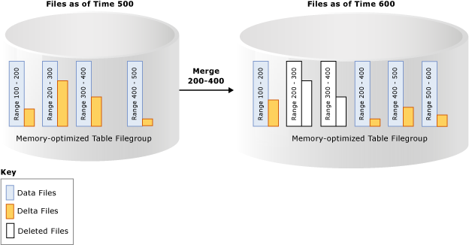
https://msdn.microsoft.com/en-us/library/dn553125.aspx

Slide 9
Uses for In-Memory Optimized tables
Fast performance for OLTP workloads
Reduction of contention in a system that experiences a lot of blocking
Temporary tables that require high level of performance (Non-Durable Schema only In-Memory Table)
Real-Time Analytics with Columnstore Index

Slide 10
Demo
In-Memory Optimized tables

